Slide 1


BIA 600: BUSINESS ANALYTICS:
DATA, MODELS & DECISIONS
COURSE PROJECT :
COVID-19 RESEARCH PROJECT - Guided by Dr. Bei Yan
Team 10:
Aakash Rathod - 10459323
Kunal Patil - 20007332
Phanindra Reddy Bommareddy - 10477935
Rohan Birwadkar - 10461464
Notes:
Aakash Start

Slide 2
Introduction
The Covid-19 Pandemic
Its impact world-wide
Preventive Measure
1

Slide 3
Problem Statement
During the pandemic, while the world was heavily affected by the virus, nations started fighting back by taking measures such as isolating affected patients, preventing the spread of infection by imposing lockdowns and finally carrying out vaccination drives.
The aim of this research project, is to find out how these preventive measures like Vaccinations and Lockdown helped in curbing the effect of COVID-19.
2

Slide 4
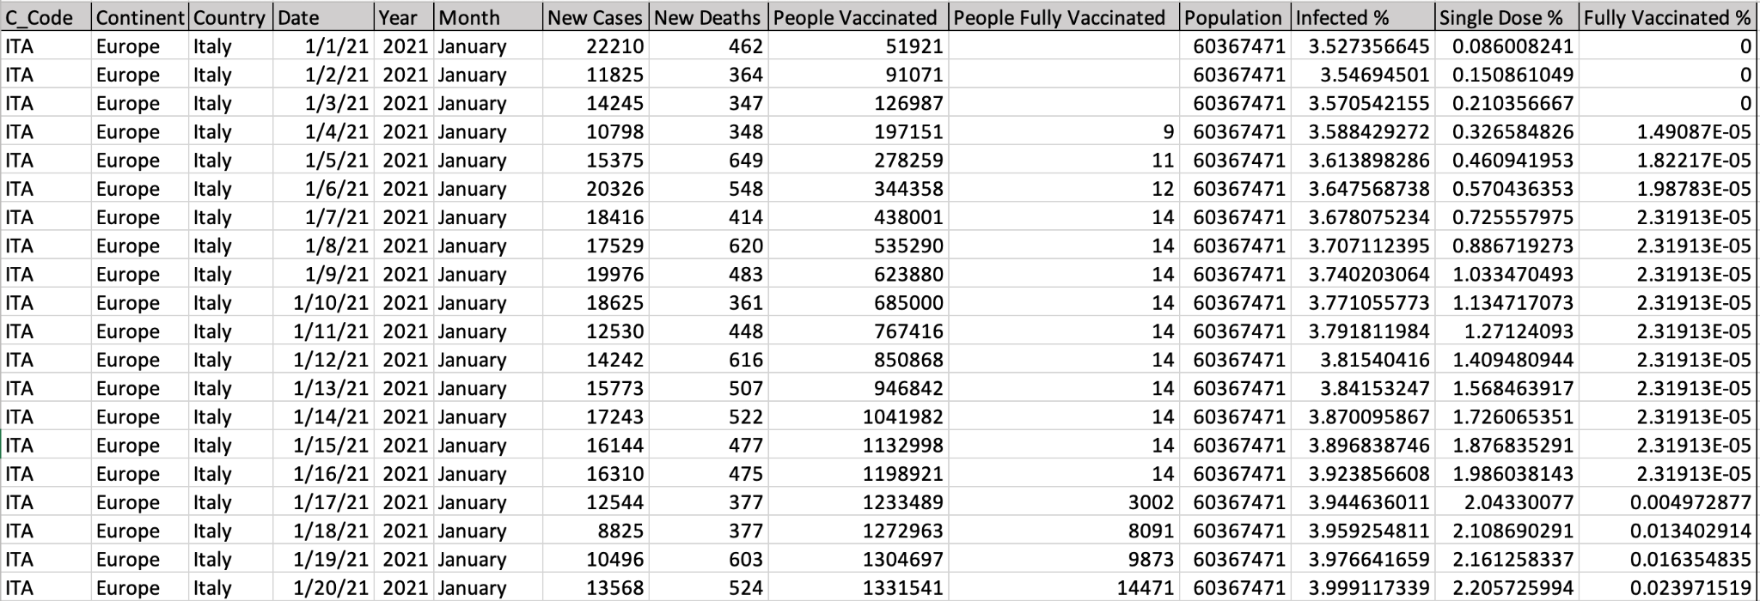
Dataset
The Covid dataset is updated with latest information daily.
It is a enormous dataset with a large number of columns. For our research, we have only focused on selected columns.
Below is a snap of the project data set.
Our Dataset ranges from 1st January 2020 - 15th November 2021, (approx 130k Records)
3

Slide 5
Dataset Information
Column Names | Measurement Scale | Values | Description
Country | Categorical | String: ‘Italy’ | Contains names of the countries
Date | Ordinal | Date: 03/03/2020 | Gives everyday date
New cases | Ratio | Numeric: 1542 | The number of cases that were found on a particular date
New Deaths | Ratio | Numeric: 2455 | The number of deaths recorded on a particular date
People vaccinated | Ratio | Percentage: 7.45% | Percentage of people vaccinated with at least 1 dose till the particular date
People fully vaccinated | Ratio | Percentage: 7.45% | Percentage of people fully vaccinated till the particular date
Positive Rate | Ratio | Percentage: 7.45% | The share of COVID-19 tests that are positive
Population | Ratio | Numeric: 146875 | The total population of a country
4

Slide 6
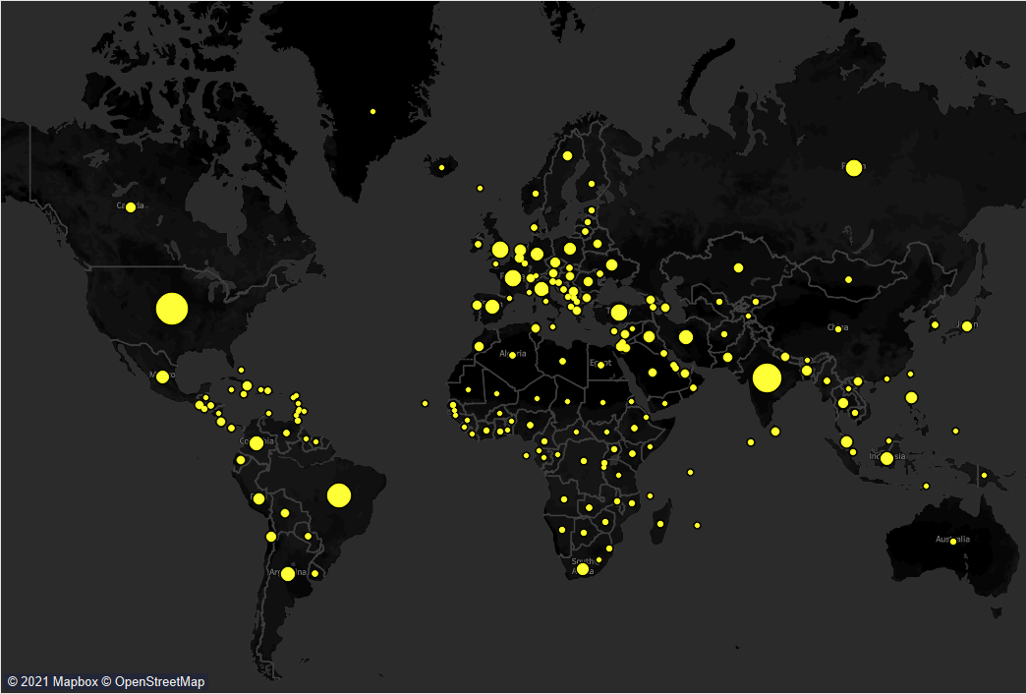
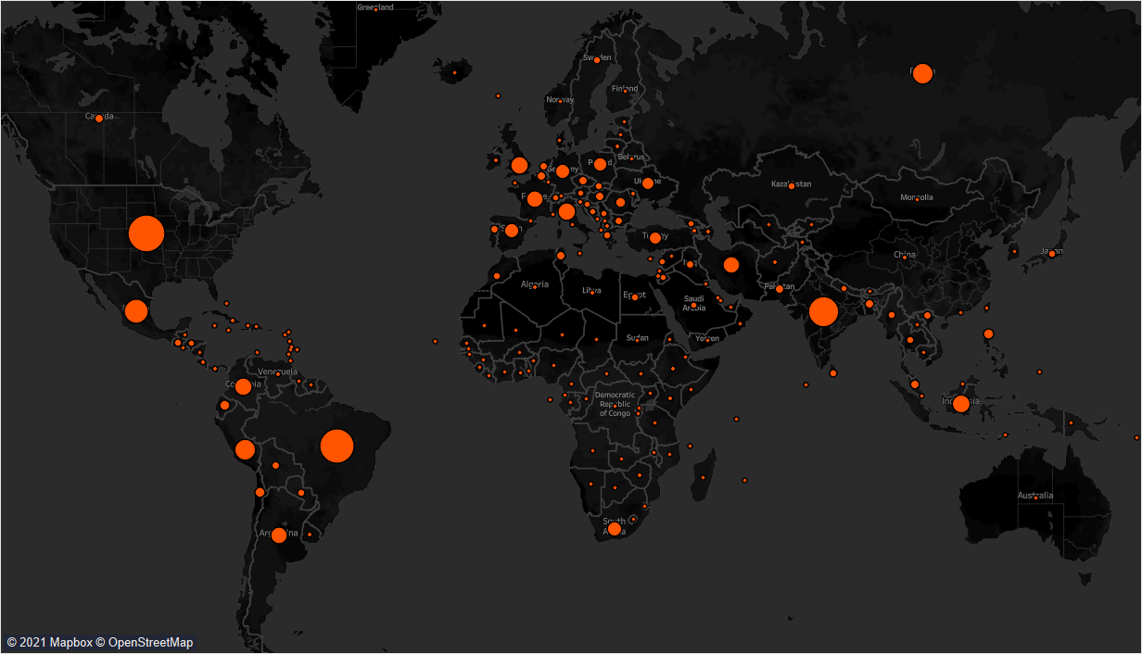
Cases & Death Map
Case Map
Death Map
Source: https://public.tableau.com/app/profile/sky6274
5

Slide 7
Hypothesis Testing
Among all the nations, Italy was one of the worst hit. The casualties due to covid in Italy were very high in comparison to other nations, if population is considered. So Italy was chosen since large-scale data is available.
At the beginning of year 2021, countries had started rolling out vaccines for Covid-19 , and so was in Italy. So let us see if these vaccinations had any positive impact on the preventing and controlling the spread of Covid-19.
6

Slide 8
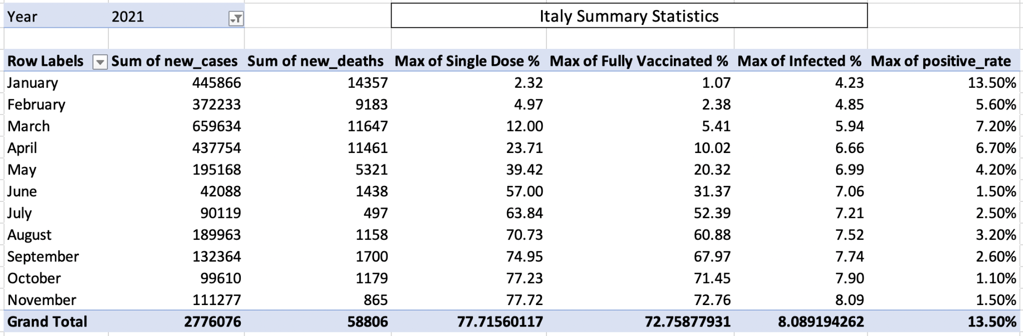
Key Variables Summary
The following table provides a summary statistics of key variables for Italy in 2021
7
Notes:
End me maam to bolte hai ki
Our data is updated daily
so it could be misleading to show max and min no. on those

Slide 9
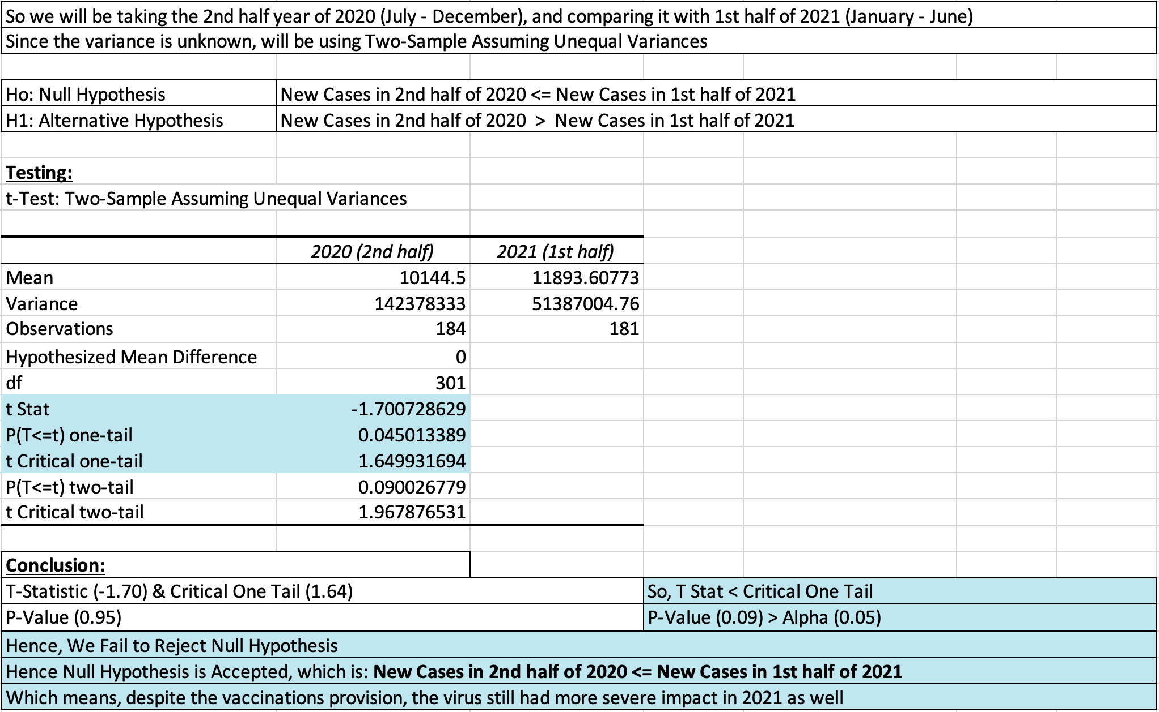
Hypothesis Testing 1
8

Slide 10
Hypothesis Testing
So from the Hypothesis Test 1, we understand that the situation got worse.
The cases still kept increasing despite the vaccination drives, even when approx 57% of Italy’s population got vaccinated by the end of June.
So, did immunizations have no influence on the number of new cases and deaths?
Let us dig deeper into year 2021 and find out!!
9
Notes:
Aakash End

Slide 11
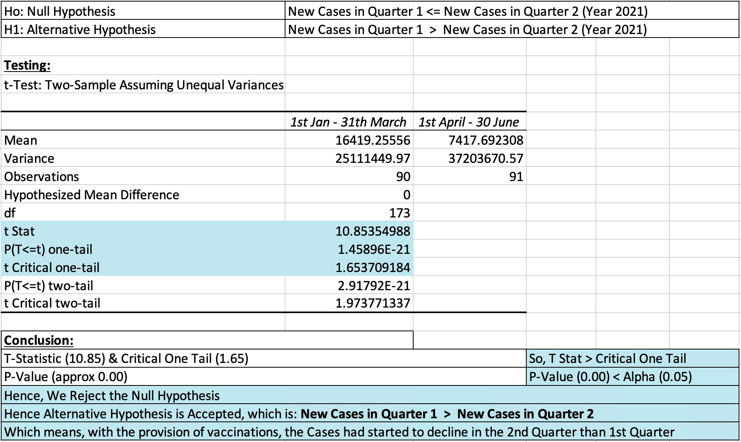
Hypothesis Testing 2
10

Slide 12

Hypothesis Testing 3
11

Slide 13
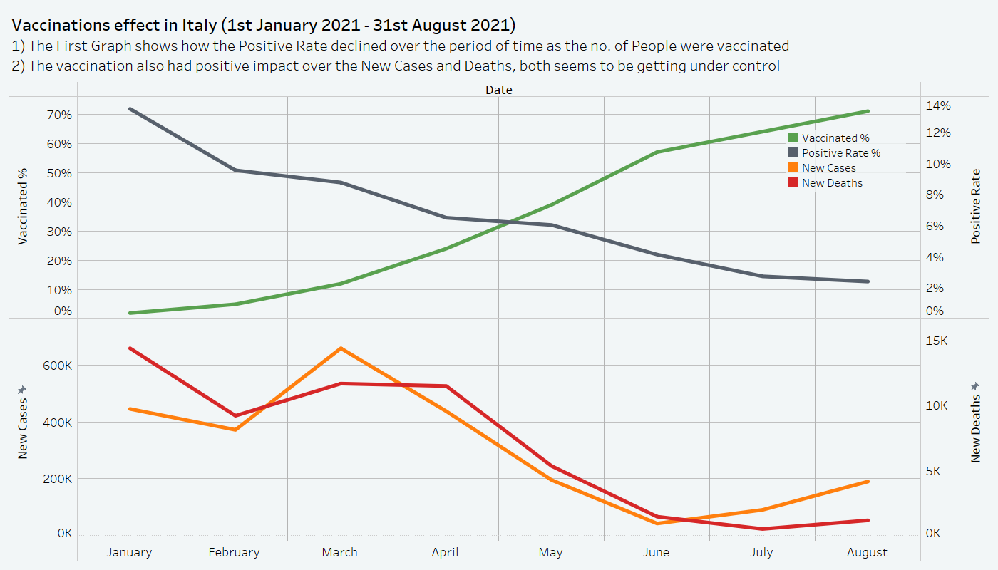
Visual Analysis
12

Slide 14
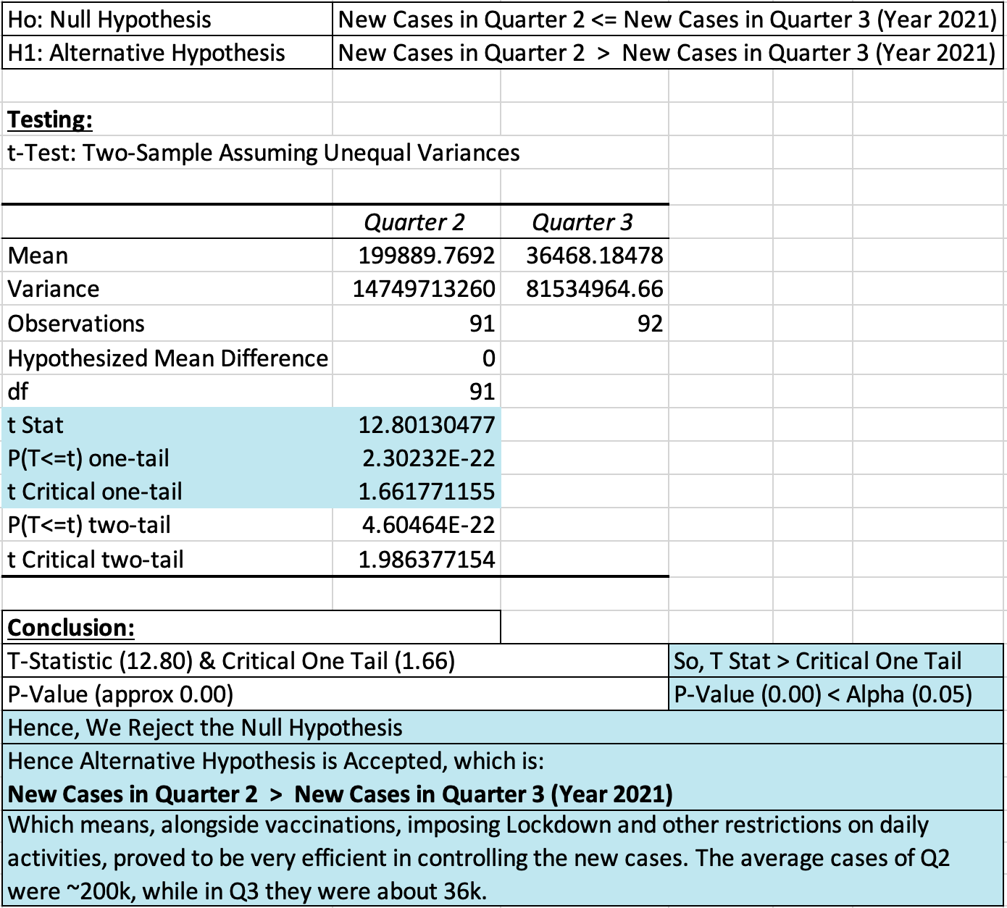
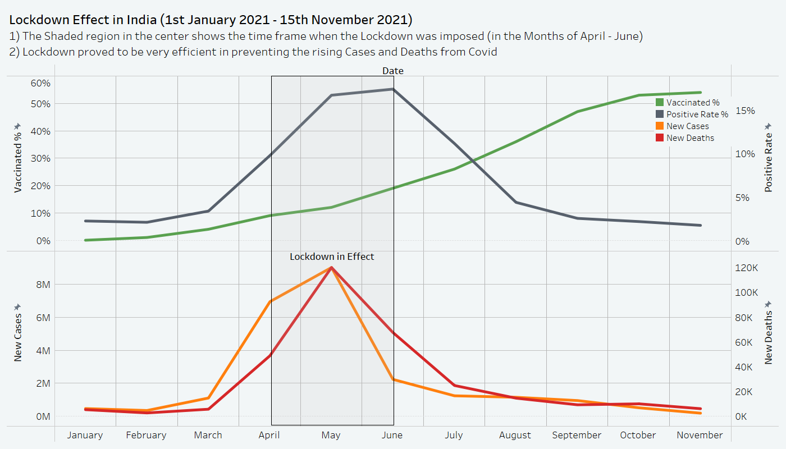
Hypothesis Test 4
Effect of Lockdown in India, in months of April - June
13
Notes:
it depicts the After effect of lockdown implementation
Hence lockdown was also efficient in stopping the immediate increase, and alongside vaccination also aided in the same

Slide 15
Inference
The preventive measures taken did abate the impact of Covid-19.
With Vaccinations provision, there is a great decline in number of new cases and deaths as compared to the previous period.
Positive rates were also seen to have fallen down hugely.
Alongside, the imposition of Lockdown proved efficient in preventing the spread of virus.
Hence, as more population gets vaccinated, the cases, deaths and positive rate will gradually decrease over time.
And Lockdown restrictions will also aid in preempting the widespread of Covid-19 virus whenever there are chances of sudden peak or outbreak.
14

Slide 16


THANK YOU !!
15

